Slide 1
산출물 종합

Slide 2
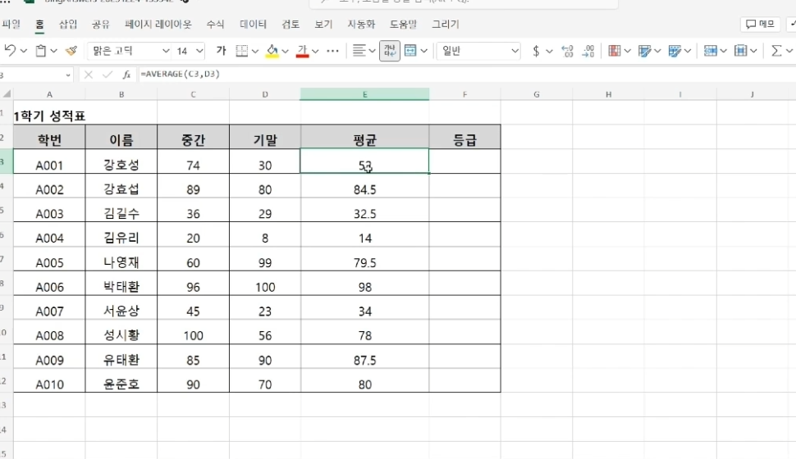
00-1 << 예시 화면

Slide 3

00-2 << 예시 화면

Slide 4
01

Slide 5
1-1

Slide 6
1-2

Slide 7
1-3

Slide 8
02

Slide 9
2-1

Slide 10
2-2

Slide 11
2-3

Slide 12
03

Slide 13
3-1

Slide 14
3-2

Slide 15
3-3

Slide 16
04

Slide 17
3-1

Slide 18
3-2

Slide 19
3-3

Slide 20
05

Slide 21
5-1

Slide 22
5-2

Slide 23
5-3

Slide 24
06

Slide 25
6-1

Slide 26
6-2

Slide 27
6-3

Slide 28
07

Slide 29
7-1

Slide 30
7-2

Slide 31
7-3

Slide 32
08

Slide 33
8-1

Slide 34
8-2

Slide 35
8-3

Slide 36
09

Slide 37
9-1

Slide 38
9-2

Slide 39
9-3

Slide 40
10

Slide 41
10-1

Slide 42
10-2

Slide 43
10-3

Slide 44
11

Slide 45
11-1

Slide 46
11-2

Slide 47
11-3

Slide 48
12

Slide 49
12-1

Slide 50
12-2

Slide 51
12-3

Slide 52
13

Slide 53
13-1

Slide 54
13-2

Slide 55
13-3

Slide 56
14

Slide 57
14-1

Slide 58
14-2

Slide 59
14-3

Slide 60
15

Slide 61
15-1

Slide 62
15-2

Slide 63
15-3

Slide 64
16

Slide 65
16-1

Slide 66
16-2

Slide 67
16-3

Slide 68
17

Slide 69
17-1

Slide 70
17-2

Slide 71
17-3

Slide 72
18

Slide 73
18-1

Slide 74
18-2

Slide 75
18-3

Slide 76
19

Slide 77
19-1

Slide 78
19-2

Slide 79
19-3

Slide 80
20

Slide 81
19-1

Slide 82
19-2

Slide 83
19-3

Slide 84
21

Slide 85
21-1

Slide 86
21-2

Slide 87
21-3

Slide 88
22

Slide 89
22-1

Slide 90
22-2

Slide 91
22-3

Slide 92
23

Slide 93
22-1

Slide 94
22-2

Slide 95
22-3

Slide 96
24

Slide 97
24-1

Slide 98
24-2

Slide 99
24-3

Slide 100
25

Slide 101
25-1

Slide 102
25-2

Slide 103
25-3

Slide 104
26

Slide 105
26-1

Slide 106
26-2

Slide 107
26-3

Slide 108
27

Slide 109
27-1

Slide 110
27-2

Slide 111
27-3

Slide 112
28

Slide 113
28-1

Slide 114
28-2

Slide 115
28-3

Slide 116
29

Slide 117
29-1

Slide 118
29-2

Slide 119
29-3

Slide 120
30

Slide 121
30-1

Slide 122
30-2

Slide 123
30-3

Slide 124
31

Slide 125
31-1

Slide 126
31-2

Slide 127
31-3

Slide 128
32

Slide 129
32-1

Slide 130
32-2

Slide 131
32-3

Slide 132
33

Slide 133
33-1

Slide 134
33-2

Slide 135
33-3

Slide 136
34

Slide 137
34-1

Slide 138
34-2

Slide 139
34-3

Slide 140
35

Slide 141
35-1

Slide 142
35-2

Slide 143
35-3

Slide 144
36

Slide 145
36-1

Slide 146
36-2

Slide 147
36-3

Slide 148
37

Slide 149
37-1

Slide 150
37-2

Slide 151
37-3

Slide 152
38

Slide 153
38-1

Slide 154
38-2

Slide 155
38-3

Slide 156
39

Slide 157
39-1

Slide 158
39-2

Slide 159
39-3

Slide 160
40

Slide 161
40-1

Slide 162
40-2

Slide 163
40-3

Slide 164
41

Slide 165
41-1

Slide 166
41-2

Slide 167
41-3

Slide 168
43

Slide 169
43-1

Slide 170
43-2

Slide 171
43-3

Slide 172
44

Slide 173
44-1

Slide 174
44-2

Slide 175
44-3

